Slide 1

FamInsure Co. Exploratory and Statistical Analysis
By Elisabeth Membel

Slide 2
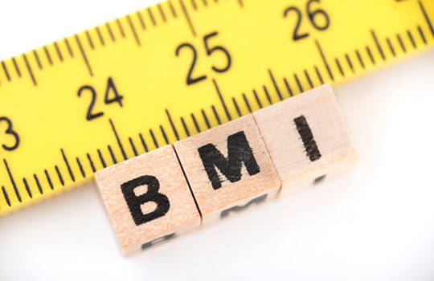
A main concern of FamInsure Co.’s customer base is rising premiums; the following analysis of customer and medical insurance charge data aids a deeper understanding of FamInsure clientele, and helps us predict insurance charges based on which factors impact insurance costs the most. Risk Assessment has identified several issues for us to explore. Let’s get started…
Issues to Explore:
Purpose:
1.) Do individuals who tend to have a higher Body Mass Index (BMI), have higher insurance charges?
1.) We want to understand the nature of a relationship between BMI and insurance charges, especially at what point(s) the relationship is stronger.
This Photo by Unknown Autor is licensed under CC BY-NC

Slide 3
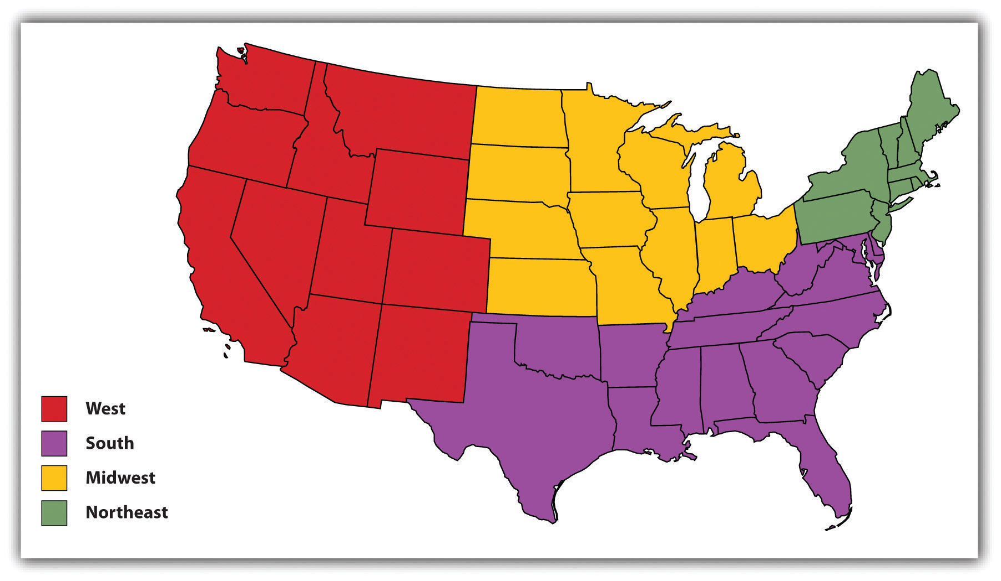
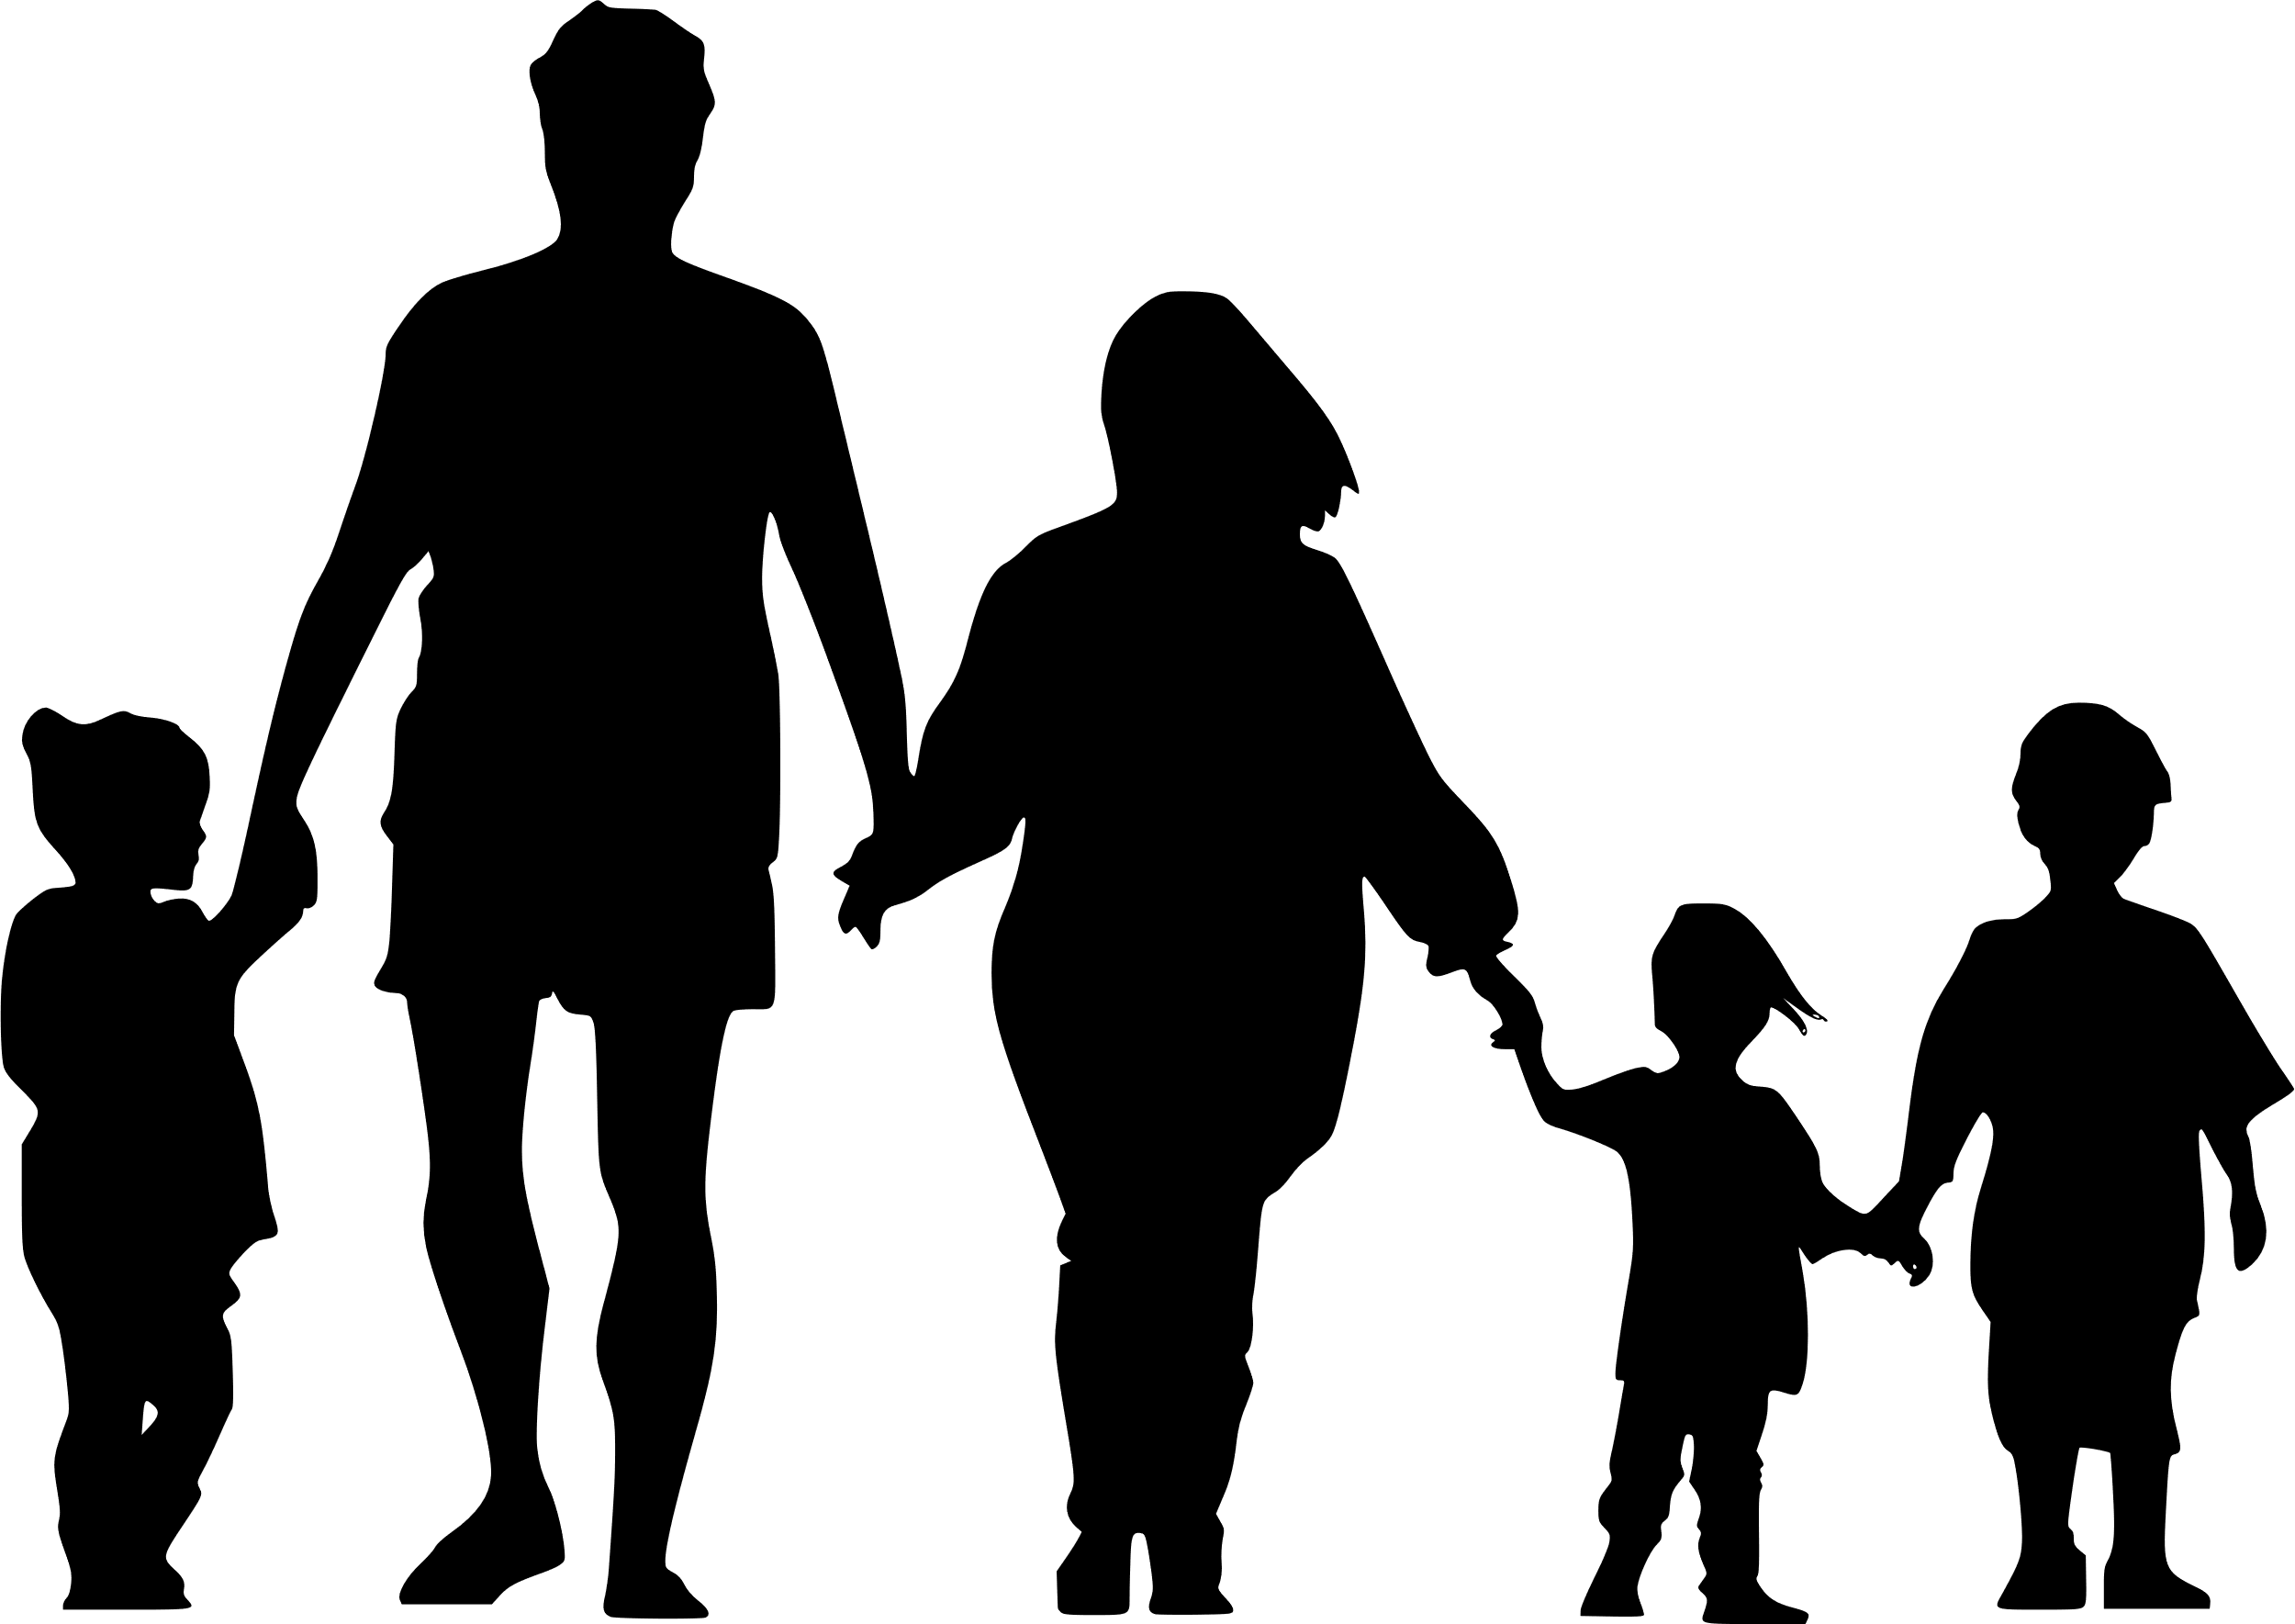
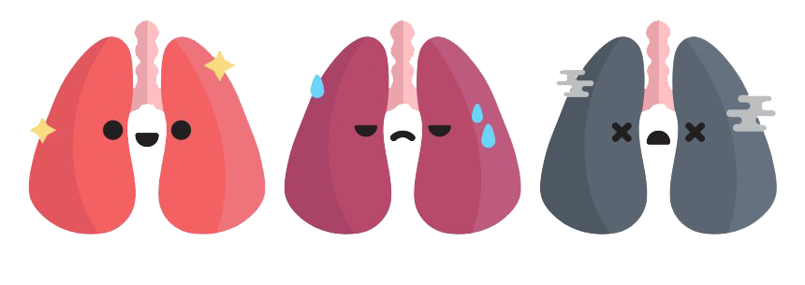
2.) Determining the level of regional impact on charges will help ensure accurate risk assessment when a geographical subgroup is added to a profile.
3.) Determine whether males have higher charges than females or the converse, if there is relationship.
4.) How much impact does behavior, specifically smoking, have on charges. Note: to clarify, this analysis is based on insurance charges, not medical costs.
2.) Does region (geography) appear to have any impact on insurance charges?
3.) Does biological gender have any impact regarding insurance charges?
PowerPoint stock Image
4.) Does smoking have any impact regarding insurance charges?
Photo by Unknown Author is licensed under CC BY-SA-NCThis
This Photo by Unknown Author is licensed under CC BY-NC

Slide 4
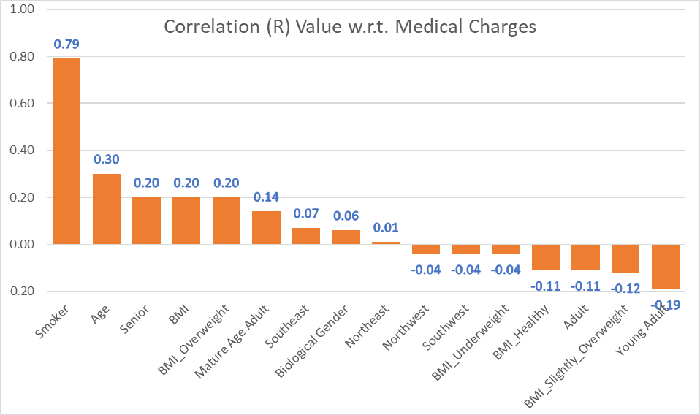
Through a combination of exploratory and statistical methodologies, three key factors emerged: Smoker, BMI, and Age. As we will later see, our model accurately predicts insurance charges based on these three factors, most notably Smoking, which confirms it is the predictor with the greatest influence on medical insurance charges within our data.
Notes:
Add stats from original slide here

Slide 5
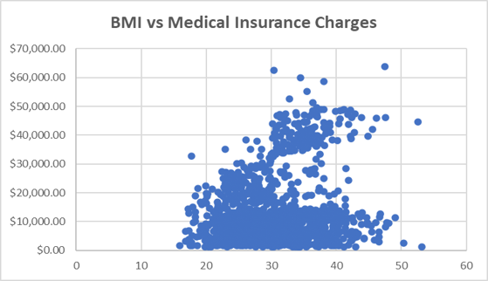
Exploratory Analysis BMI: exploratory comparison of medical insurance charges against BMI weight classification does not immediately yield a clear relationship, but grouping by BMI classification will…

Slide 6
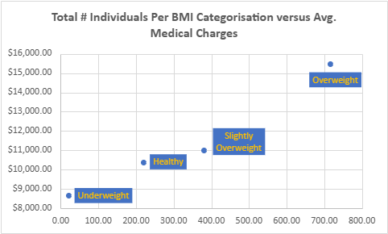
When clustered by BMI groupings (Underweight, Healthy, Slightly Overweight, and Overweight) a weak direct relationship is observed, where charges increase as BMI increases, especially from Slightly Overweight to Overweight (40.7 percent increase).
Notes:
For BMI grouping parameters the CDC breakdowns were used as follows:
Underweight includes BMI less than or equal to 18.5;
Healthy includes values above 18.5 through 24.9;
Slightly Overweight Group includes BMI from above 24.9 through 29.9;
Overweight Group includes all those values above 29.9.

Slide 7
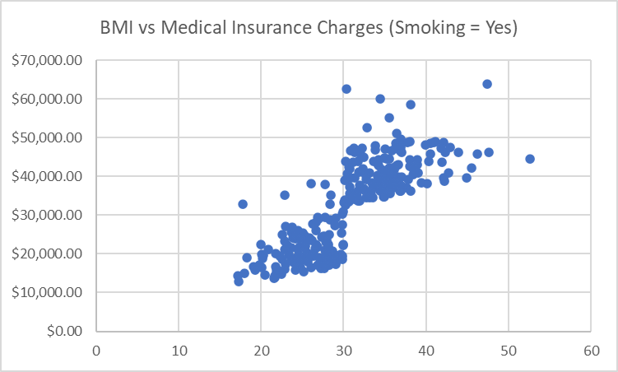
BMI Smoking Effect: When we further segment BMI classification by Smoking (Yes, No) the presence of smoking seems to have a stronger relationship to higher insurance charges than BMI classification.
Notes:
For BMI grouping parameters the CDC breakdowns were used as follows:
Underweight includes BMI less than or equal to 18.5;
Healthy includes values above 18.5 through 24.9;
Slightly Overweight Group includes BMI from above 24.9 through 29.9;
Overweight Group includes all those values above 29.9.

Slide 8
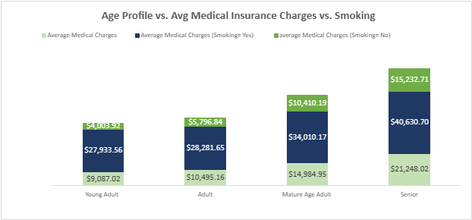
In the light of this result, we filtered our Age groupings for smoking as well. Average Insurance Charges tend to be 2-3 times higher for those who smoke than for those who do not across age groups. While the Senior group has the highest charges overall, the Mature Age group sees the greatest overall increase of 46.5 percent. Looking at smoker only, insurance charges for Young Adults are already very high, while the greatest percentile increase of $5728.52 (20.3%) occurs again at the Mature Age group, with our Senior Age group a close second (19.6%).
Notes:
Young Adult = 18 - 25
Adult = 26 - 35
Mature Age Adult = 36 - 59
Senior = 60 and up

Slide 9
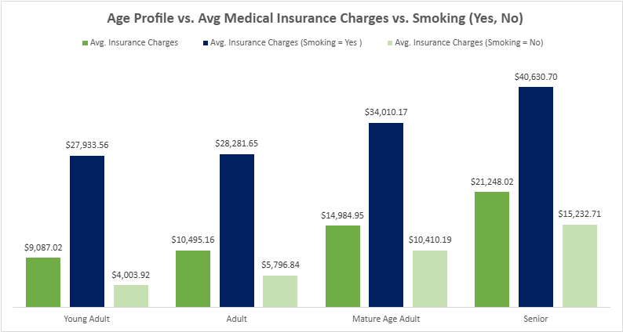
The transformation on the right makes this clearer. While average charges increase with age, the blue column (those who smoke) dwarfs the others. Within the Mature Age Adult average charges for those who smoke reach $34,010.17, which is 297% higher than the average charges for Mature Age Adults who do not smoke.
Notes:
Young Adult = 18 - 25
Adult = 26 - 35
Mature Age Adult = 36 - 59
Senior = 60 and up

Slide 10
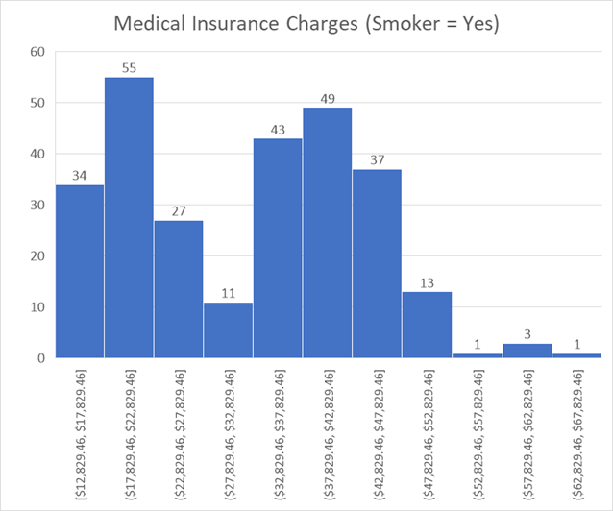
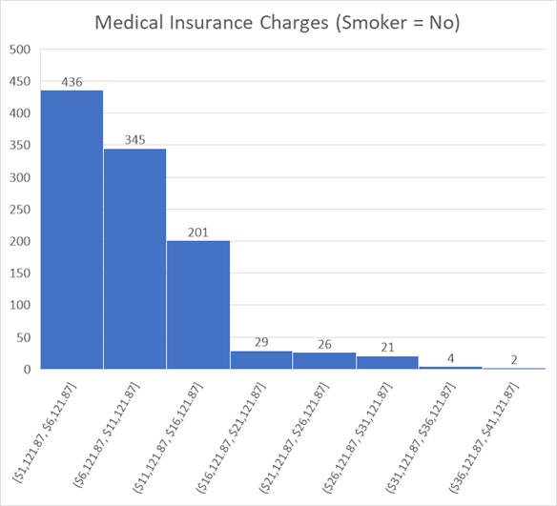
Our exploratory analysis has pointed to the impact of smoking on insurance charges. Looking at this factor or predictor alone, we see smoking has a dramatic effect on insurance charges within our data. The difference in minimum medical insurance charges between those that smoke ($12.8K) and those that don’t smoke($1.1k) are as high as $11.7K (over 11 times greater), with the bulk of non-smokers having insurance costs less than 11K.
Notes:
Here I have grouped insurance charges in 5,000 dollar increments from least to greatest.
The lowest charge for our Smoker group (chart on the left) is $12,829.46, and the lowest charge for our Non-smoker group (chart on the right) is $1,121.87.

Slide 11
Beginning our statistical analysis, we find the Correlation Values with respect to Medical Insurance Charges back up the findings from our initial exploratory phase. The highest correlation values we see are Smoking (0.79), Age (0.30), and BMI (0.20), particularly BMI_Overweight (0.20).
Smoker | 0.79
Age | 0.30
Senior | 0.20
BMI | 0.20
BMI_Overweight | 0.20
Mature Age Adult | 0.14
Southeast | 0.07
Biological Gender | 0.06
Northeast | 0.01
Northwest | -0.04
Southwest | -0.04
BMI_Underweight | -0.04
BMI_Healthy | -0.11
Adult | -0.11
BMI_Slightly_Overweight | -0.12
Young Adult | -0.19
A correlation value is simply a measure of how much a predictor in our set influences the strength and the direction of the relationship with what we are measuring, insurance charges in our case.
Notes:
Correlation Values Interpretation:
Strong = 0.7 and up (or -0.7 lower),
Moderate = 0.3 to 0.7 (or -0.3 to -0.7), and
Weak = 0.3 (or -0.3) weak.
The correlation function, often visualized as a line of best fit on a scatter plot, quantifies the strength and direction of the linear relationship between two variables, with a correlation coefficient indicating how closely data points cluster around the line.
Correlation values obtained using the CORREL function in Excel.
Source: AI via Newcastle University’s “Pearson’s Product Moment Correlation Coefficient, r”
(https://www.ncl.ac.uk/webtemplate/ask-assets/external/maths-resources/statistics/regression-and-correlation/strength-of-correlation.html#:~:text=Correlation%20Coefficients&text=The%20closer%20the%20data%20points,monotonic%20correlation%20between%20two%20variables.)

Slide 12
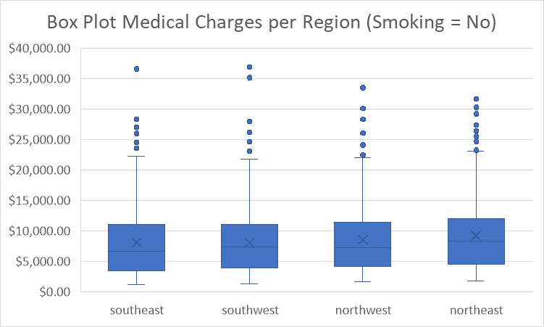
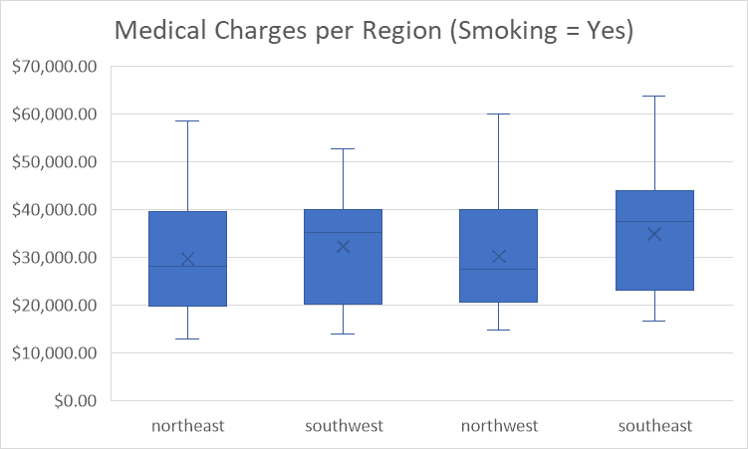
Our model results reinforce our exploratory analysis further; the same factors (Smoking, Age and BMI) most strongly associated with insurance charges emerge again and Smoking is by far the most reliable predictor of insurance charges in our model below.
Since positive values indicate a direct relationship, meaning an increase in the predictor value sees an increase in the factor being measured, we can see that the positive “coefficient” numbers shown in orange here mean there is a stronger direct relationship to medical insurance charges.
NOTE: Negative numbers associated with predictors that have positive correlation values (such as Mature Age Adult and Senior here) often indicates multicollinearity, or relationships between these or other predictors that is affecting the model and may obfuscate the relationships of our individual predictors to insurance charges here. This makes sense, given the dramatic effect we saw in our data when including or excluding smokers, but does warrant further investigation.
 | Coefficients
Intercept | -5419.1366
1338 | 314.3509861
bmi | 150.930215
BMI_Healthy | -2875.518071
BMI_Overweight | 0
BMI_Slightly_Overweight | -2592.295596
BMI_Underweight | -3294.815288
Biological Marker | -113.8248882
Smoker | 23881.96182
southeast | -546.8211698
southwest | -549.430056
northwest | 0
northeast | 374.6216289
Young Adult | 0
Adult | -1563.689549
Mature Age Adult | -2358.816517
Senior | -2149.696049
I also noted that the northeast factor in our model has a higher positive coefficient than some of our key factors, but had a lower correlation value. This indicates that there is a direct relationship with medical insurance charges, but that it is very weak.
Notes:
Note: The LINEST function in Excel was use to create a linear regression model. I also used the data analysis package to redo my calculations. With an R Squared value of 75.5%, our multiple regressive equation has a strong linear fit (with Smoker, BMI, and age having the largest positive coefficients also having a high correlation value).
I noted that the northeast factor in our model also has a positive coefficient which indicates a positive or direct relationship with medical insurance charges. However, the correlation value was lower. This indicates that there is a direct relationship, but that it is very weak.

Slide 13
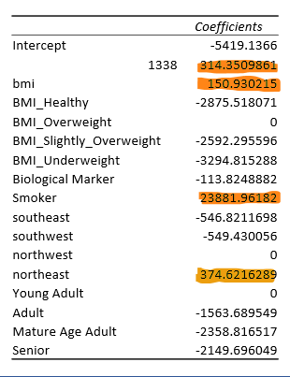


Our overall model has an R-square of 0.755, which means that 75.5% of the variation in insurance charges is explained by a relationship to the variations in our model’s combined predictor data.
Regression Statistics
Multiple R | 0.868828171
R Square | 0.754862391
Adjusted R Square | 0.75018959
Standard Error | 6025.196708
Observations | 1338
The “R Square” value, shown in teal, tells us how much our charges data can be explained by a relationship to the predictors data. The closer we get to 1.0, the stronger the (direct) relationship.

Slide 14
Since our model fits our data well (R square of 0.755 which means that 75.5%), we can now forecast medical insurance charges based on a value of a predictor, such as age. For example, if we know which predictors a customer falls under, we can forecast what their average medical insurance charges will likely be. Note: Our model enables us to create a forecast within a Median Error Percentage of -9.89%, which is within the range of good performance. This works out to forecasting our charges within $509 of the actual values and tending to undervalue rather than overvalue.
Notes:
An R-square of 0.755 means that 75.5% of the variation in insurance charges is explained by our model’s predictors.
“The MAE is simply the absolute difference between the actual value and the predicted value. So: |58- 52| = 6
The MAPE is the same but divided by the actual value. So: |58–52|/58 = 0.103. The MAPE value is a percentage, so can be multiplied by 100. For this example, the difference is just greater than 10%.
From this we can see that the lower the value, the better the performance is for both metrics.”
MAPE vs MAE: Which Metric is Better? By Lauren Gilbert, published on Medium.com
(https://medium.com/trusted-data-science-haleon/mape-vs-mae-which-metric-is-better-68dd559cbfb1#:~:text=The%20MAE%20is%20the%20easiest,performance%20is%20for%20both%20metrics.)
Research Gate (https://www.researchgate.net/figure/nterpretation-of-typical-MAPE-values_tbl1_257812432)
C3 AI (https://c3.ai/glossary/data-science/mean-absolute-percent-error/#:~:text=What%20is%20Mean%20Absolute%20Percent%20Error%20(MAPE),as%20the%20mean%20of%20absolute%20relative%20errors:)

Slide 15
Our exploratory analysis coupled with statistical analysis serves to inform our assessors on what factors are driving medical insurance charges the most within FamInsureCo.’s customer base.
Charges increased by BMI categorization grouping, with a notable jump at the overweight category, and a more dramatic effect on charges was noted when segmented further for smoking;
We saw that the minimal insurance charges were up to 11X greater for smokers than for non-smokers
Lastly, while charges increased incrementally for each age group, the increases were largest for the Mature_adult while the Senior group had the highest overall charges. Smoking increases the charges by 2 to 3-fold in each age grouping.
Notes:
These are the factors that are disproportionately affecting our risk pooling.

Slide 16

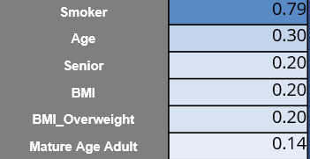
Our statistical analysis found that Smoking has both the highest correlation value (0.79) and by far the greatest positive regression coefficient (23882), indicating the strongest direct relationship to medical insurance charges.

Slide 17
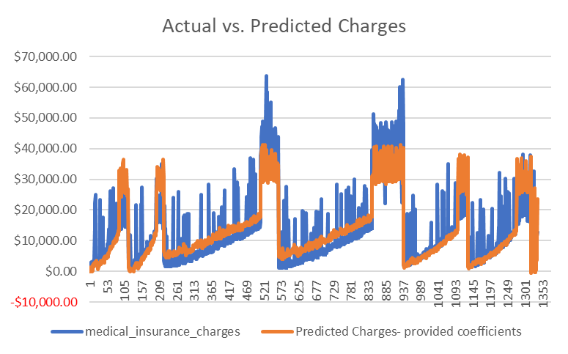

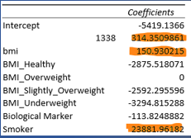
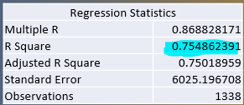
Smoking, BMI, and Age have the highest positive correlations to insurance charges, and because our predictors explained our charges well (R square value of 0.755), our model allows us to predict charges within a range of $509 (median percentage error of 9.89%).

Slide 18
While these findings within our data give us a clearer picture of our customer base and inform which factors affect risk assessment and risk pooling the most, future work reevaluating the accuracy of our risk assessment protocols will involve combining both insurance costs and medical costs accrued to determine on what level and to what extent they are aligned and proportional. This will involve incorporating additional data sets and running a new model on predictors of medical costs.
Thank You
www.linkedin.com/in/elisabeth-membel-b00059274
All non-chart images unless otherwise noted are PowerPoint stock images supplied by Microsoft PowerPoint.

